Slide 1
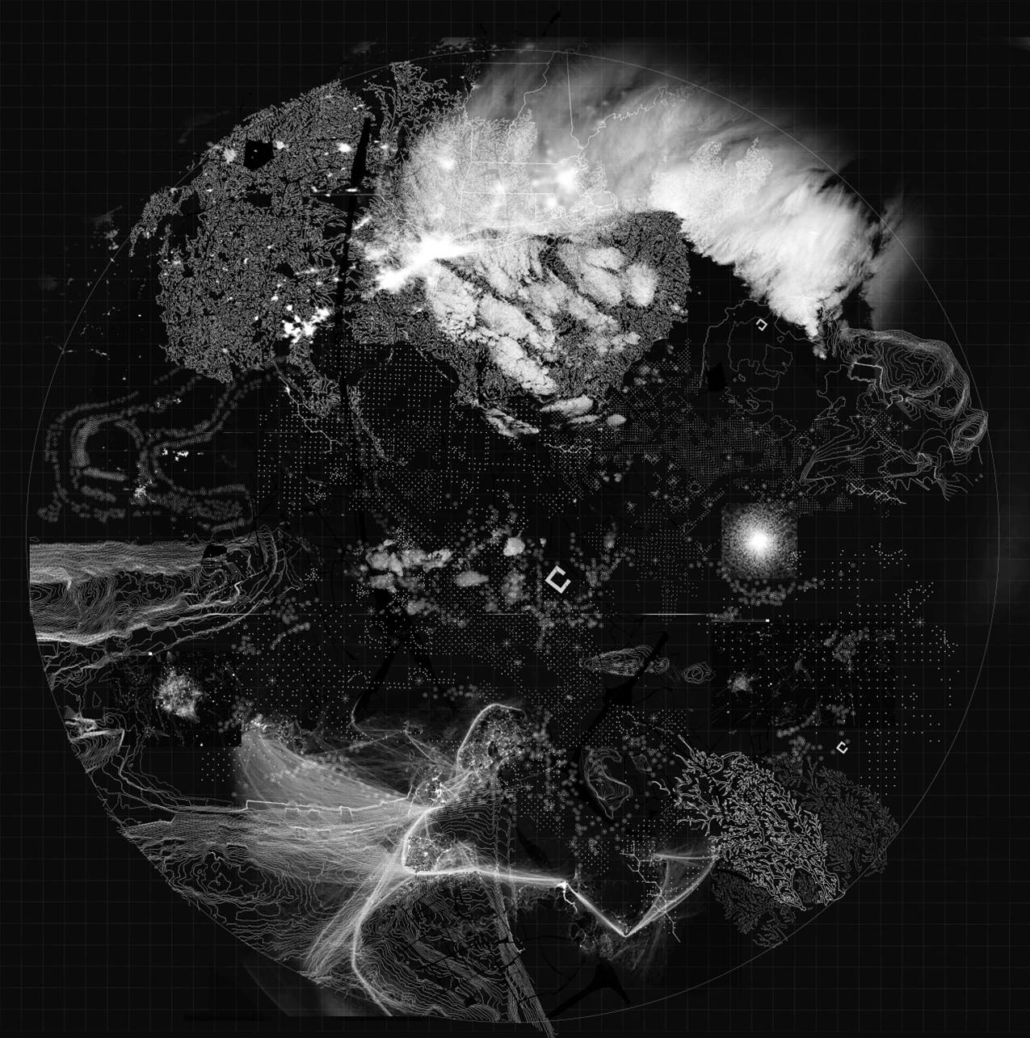
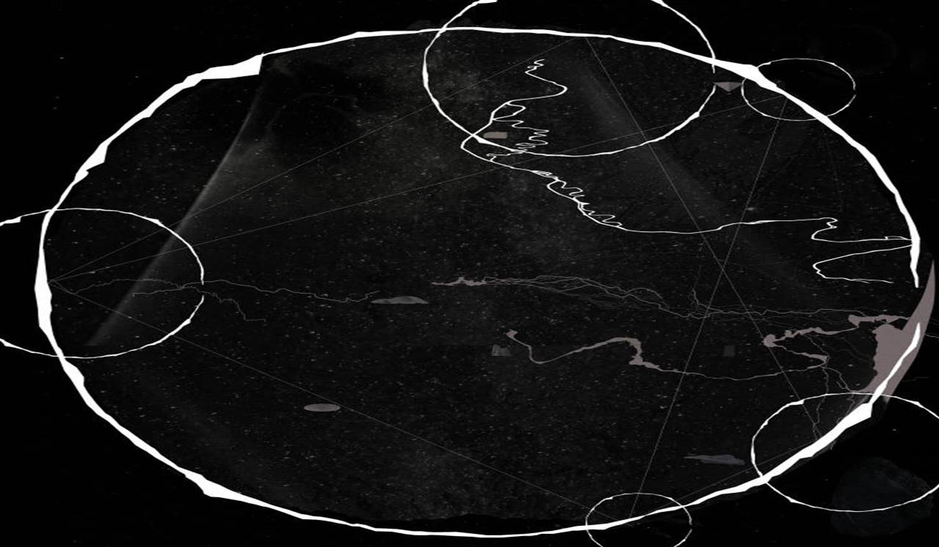
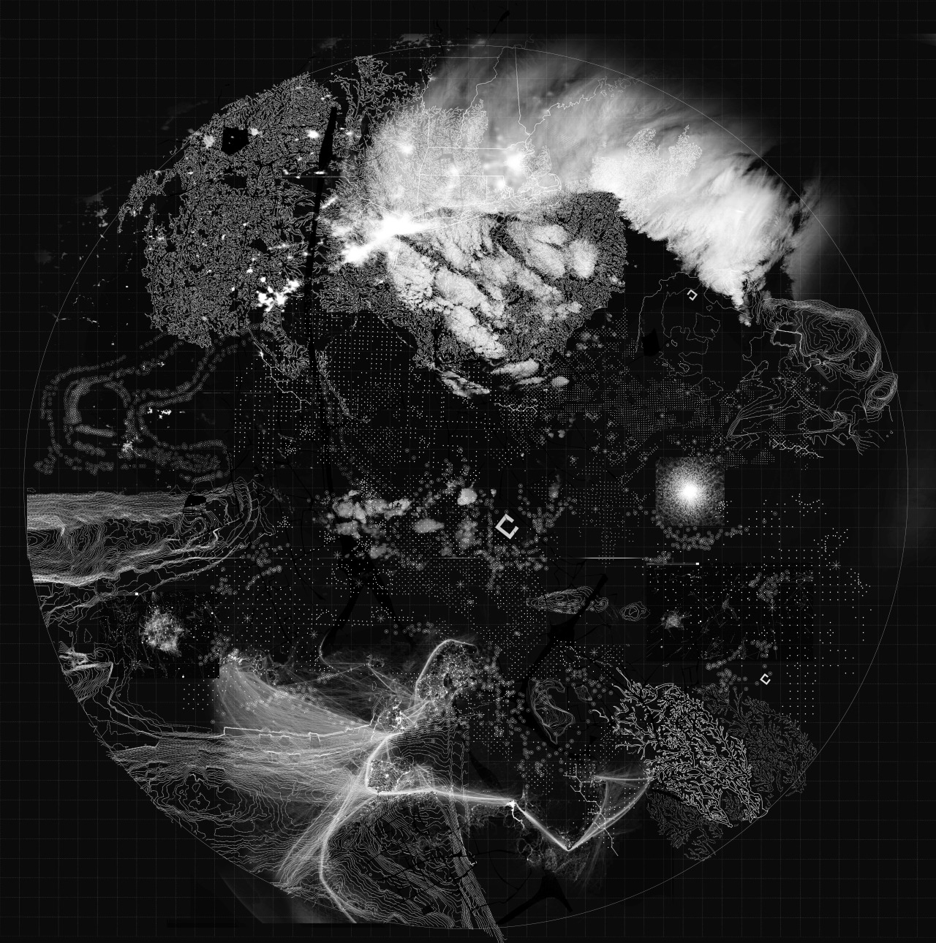
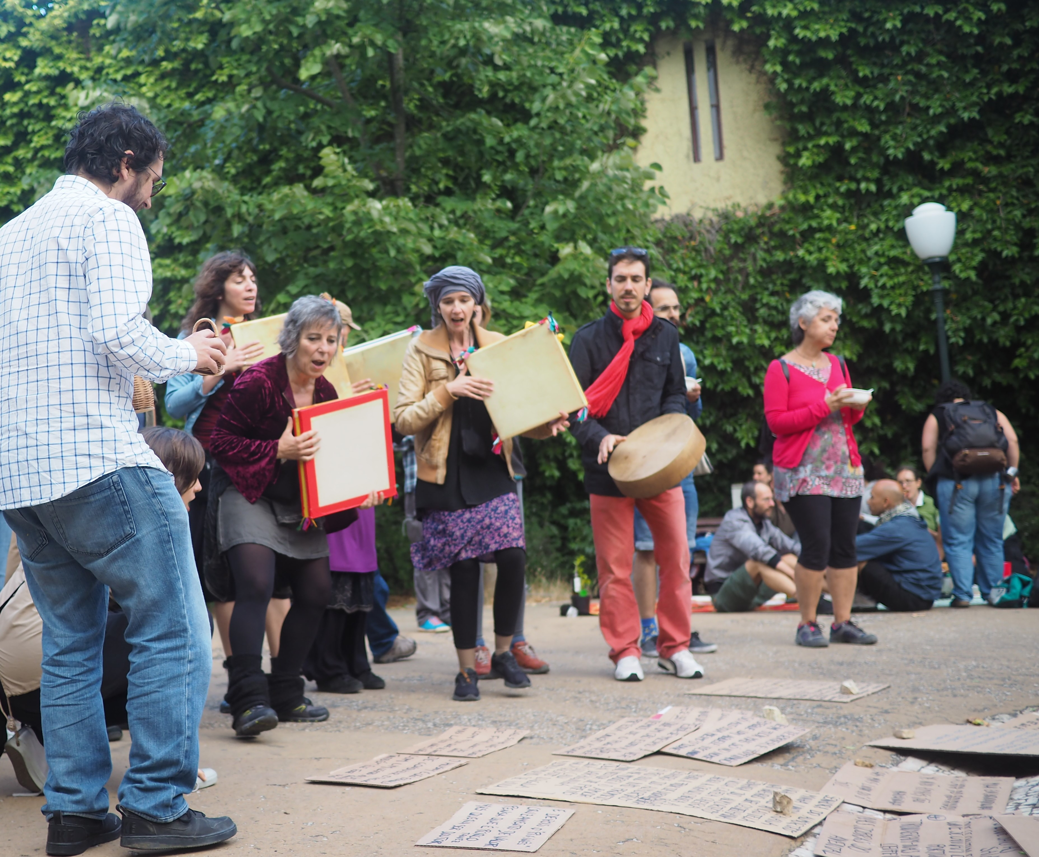
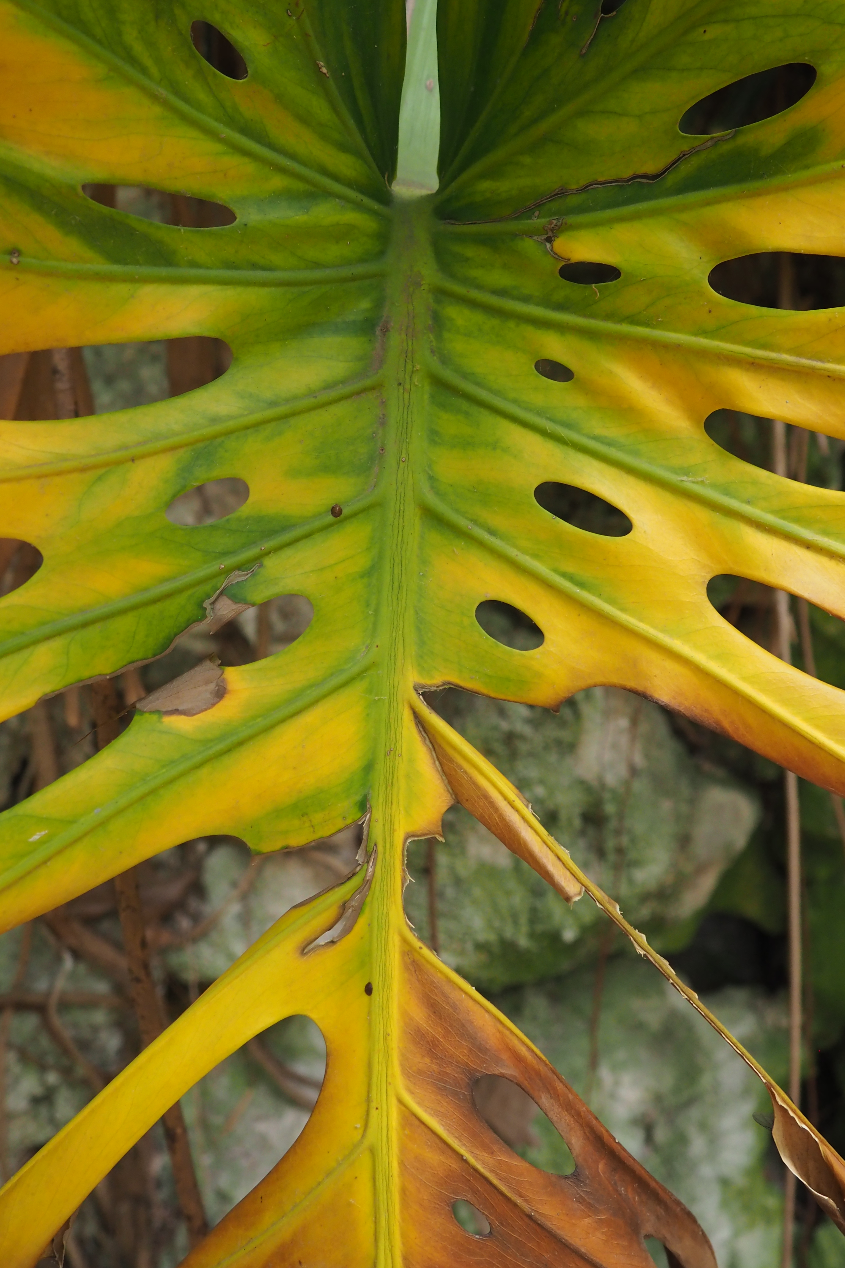



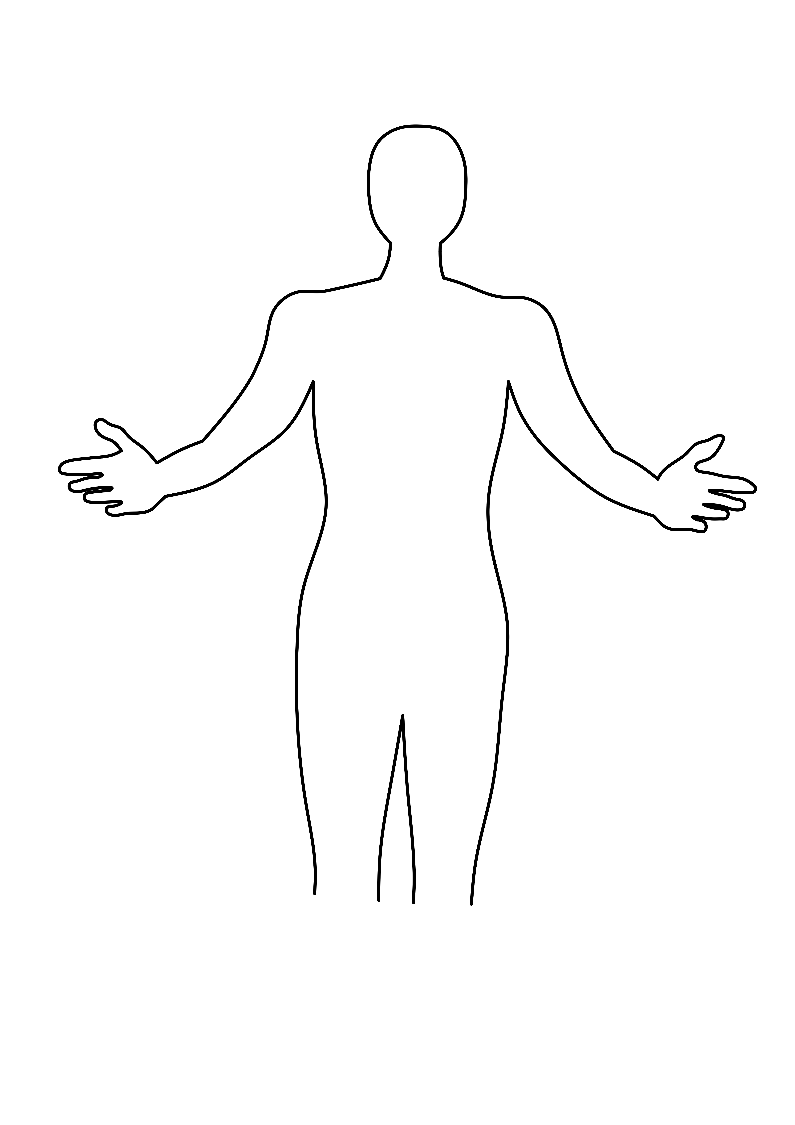
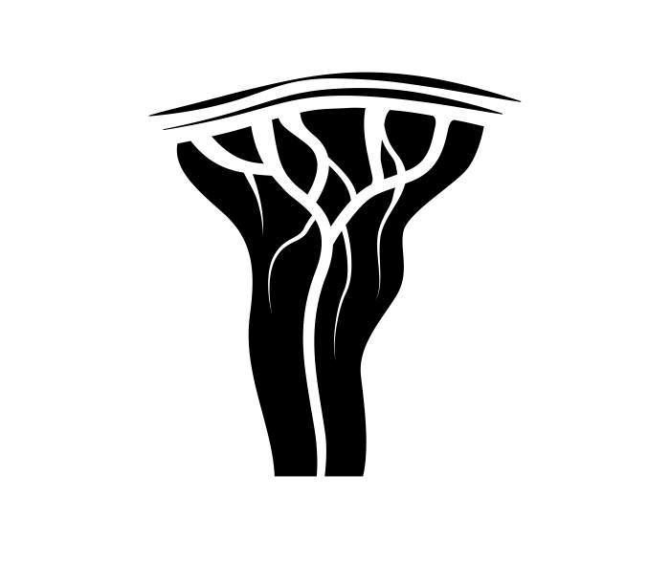
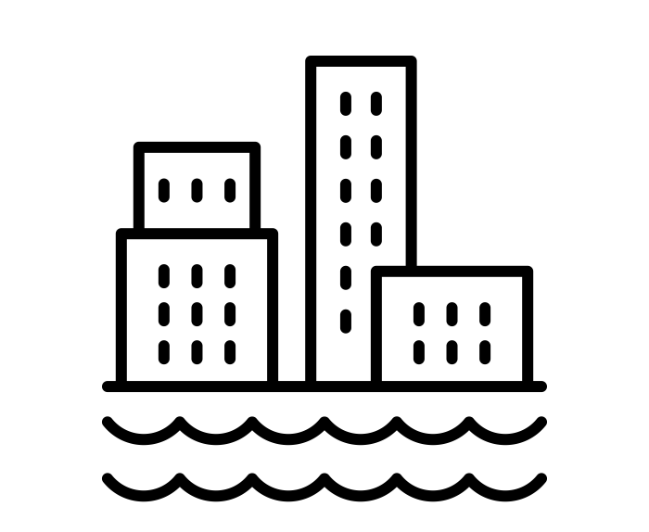
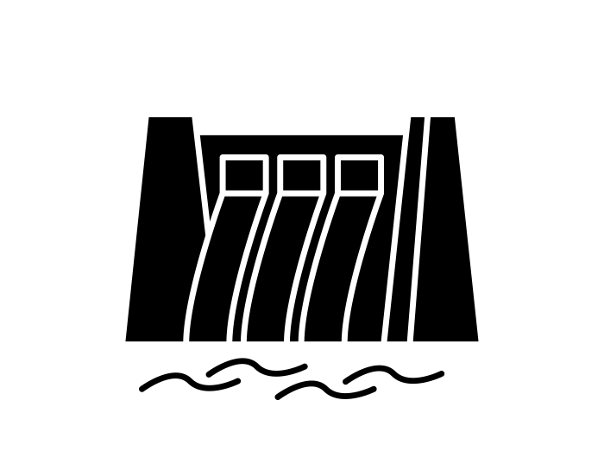
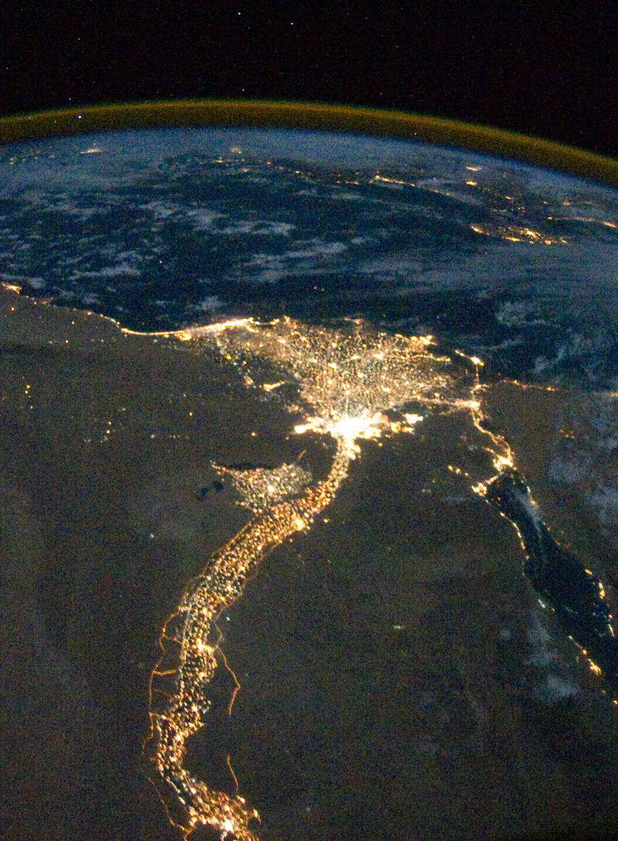
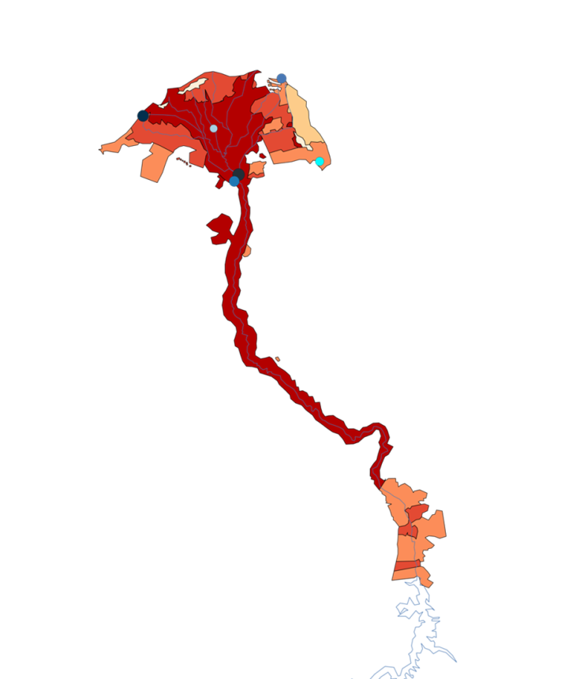
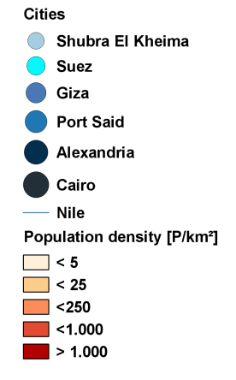






LaPlPla
THE NILE DELTA – A CRITICAL ZONE?
Julia Dickow – M.Sc. Geography of Global Change
AN INTERDISCIPLINARY PERSPECTIVE ON GLOBAL CHANGE
THE GAIA-HYOPTHESIS
SEARCHING FOR THE TERRESTRIAL
Gaia, defined as „[the] complex entity involving the Earth's biosphere, atmosphere, oceans, and soil” ^{[6]}, makes reference to the primal Mother Earth goddess in Greek mythology. The Gaia hypothesis proposes that all organisms and their inorganic surroundings on Earth are closely integra-ted to form a single and self-regulating complex system, maintaining the conditions for life on the planet. The Earth as Gaia is neither only a resource, nor a ward or a breastfeeding mother, it’s a living planet. ^{[7, 8]}
“The terrestrial is actually a political science term to describe where all of us will finally land at the end of modernism. Thus, it is a concept to describe the Earth, differing from the Globe, [in] a triangle formed between the Globe, the Local, and the Terrestrial” ^{[1]}. The project DE\GLOBALIZE is an example for this search movement for the Terrestrial – using the transdiscipli-nary concept of the Critical Zone. From 2018 to 2020, three critical zones (IISc Bangalore, Nile Delta & Upper Rhine Valley) are studied.^{[2]}
HAVE A LOOK !
ACTOR-NETWORK-THEORY (ANT)
*
Nature and culture, nature and social issues, as well as technology and social issues are no longer seen as irreconcilable opposites. Within hybrid networks between nature, the world of things and society, numerous actors (or actants) – human, animal, plant, mate-rial – constantly create new connections and ensure the emergence of new social bonds and the collapse of others. Things become actants in the play of forces when they have an effect, that is, when their presence or absence would change something essential (e.g. the ozone hole as a hybrid/quasi-object, constituting an actant-network of chlorofluoro-carbons, air masses, consumers, industrial plants, environmentalists, etc.).^{[3, 4, 5]}
*
FIND OUT MORE !
CULTURE
NATURE
GLOBAL
TRENDS, AGENCIES & VULNERABILITIES
DOWN TO EARTH IN THE NEW CLIMATE REGIME
GLOBAL
DECLINING WATER RESOURCES
POPULATION
GROWTH
GEOPOLITICAL CONFLICTS
*
The observation of Critical Zones of various, shifting dimensions, based not only on ecological crises, but also on questions of politics and cultural history as well as on epistemological changes of perspective, is framed within the assumption a New Climate Regime. This term is used to describe the current global situation, in which climate change, along with other eco-crises call into question the once-universal dream of “development” and globalization, leaving profound disorientation. ^{[9,} ^{11]}
LOCAL
CRITICAL ZONE (CZ)
RIVERS & ESTUARIES
CRITICAL INFRASTRUCTURES
The term, taken over from the geosciences – originally referring to a spot on the envelope of the biosphere –, is extended by Bruno Latour to describe a critical, participatory relationship of humans to their living environment. Instead of a single human agency “on the nature”, this interdisciplinary approach parses the ideas of the living planet in smaller pieces by tracing diverse combinations of multiple heterogeneous agencies. Within the CZ, all interacting „ingredients“, e.g. laws, cultural and economic practices, political and ethnical conflicts, soil, water, animals, scientific theories, etc. are considered on the very same level. ^{[9,} ¹⁰, ^{12]}
^{[A]}
URBAN AREAS
^{[E]}
MORE-THAN-HUMAN AGENCIES ^{[9, 13]}
PERFORMING THE (DE-)COMPOSITION OF THE WORLD(S) ^{[13]}
BIOLOGICAL
MATERIAL
CULTURAL
INTERTWINED SCALES AND DIMENSIONS ^{[13, 15, 16]}
CRITICALITY & RESPONS-ABILITY
CZ-research points out the hybridity between being immersed in and producing criticality through monitoring and responding.
VULNERABILITY
Humans, dealing with and entangled in multiple matters of care/concern, are attributed an integral part in de- and reconstructing criticalities.
MATTERS OF CARE/CONCERN VS. MATTERS OF FACT
LOCAL
Micro- and macrolevels are seen as intertwined. Instead of sharp borders, there is a permanent shifting and scaling of dimesions.
Globalisation (world as a totality and indistinct reality) vs. Mondialisation (expansive pocess of world-forming)
No place, matter or actor is dominant enough to be predominantly global, nor self-contained enough to be only local.
GLOBAL
TERRESTRIAL
^{[B]}
THE NILE DELTA
^{[C]}
By engaging with the term „critical“, both nature and culture are embraced as vulnerable, unsteady and unpredictable entities.
As a main central water resource for ten African nations, the whole region around the Nile basin – stating a population growth of more than 2% a year – could be framed as a Critical Zone. Due to data availability restrictions, this research focusses on water as a critical matter in the Nile Delta Region. Within this CZ, not only the balance between population and food security is highly affected by the access to water, the criticality also embraces aspects such as water quality or the estuarine ecosystem, forming a complex actant-network, vulnerable to socio-political dynamics and climate change. ^{[14]}
^{[D]}
METHODOLOGY
ARTISTIC RESEARCH
SCIENTIFIC RESEARCH
^{[E]}
References
1 Suzuki, Y. (2018) ‘Booting up the Critical Zone. Interview with Bruno Latour.’ ZKM, Karlsruhe. 2 Fetzner, D. and Dornberg, M. (2018) ‘DE\GLOBALIZE (2018-20). Agential cuts through Critical Zones in Science and other Sediments – Kabini, Nile and Rhine.’ Available at: http://www.metaspace.de/Main/Deglobalize (Accessed: 15 January 2020). 3 Latour, B. (2000) ‚Die Hoffnung der Pandora: Untersuchungen zur Wirklichkeit der Wissenschaft.‘ Frankfurt am Main: Suhrkamp. 4 Latour, B. (2010) ‚Eine neue Soziologie für eine neue Gesellschaft. Einführung in die Akteur-Netzwerk-Theorie.‘ Frankfurt am Main: Suhrkamp. 5 Latour, B. (2010) ‚Das Parlament der Dinge. Für eine politische Ökologie.‘ Frankfurt am Main: Suhrkamp. 6 Lovelock, J. [1979] (2000) ‘Gaia: A New Look at Life on Earth’. Oxford: Landmark Science. 7 Gendering Mint Digital (2020) ‘Gaia.’ Available at: https://genderingmint.pageflow.io/gaia#215459 (Accessed: 20 January 2020). 8 Haraway, D. (2018) ‚Unruhig bleiben: Die Verwandtschaft der Arten im Chthuluzän.‘ Frankfurt am Main: Campus Verlag. 9 Latour, B. (2014) ‘Some Advantages of the Notion of “Critical Zone” for Geopolitics’, Procedia Earth and Planetary Science, 10, pp. 3–6. 10 Arènes, A.; Latour, B.; Gaillardet, J. (2018) ‘Giving depth to the surface: An exercise in the Gaia-graphy of critical zones’, The Anthropocene Review, 5(2), pp. 120-135.
‘Bruno Latour on Politics in the New Climatic Regime.’ Available at: https://www.resilience.org/stories/2019-03-21/bruno-latour-on-politics-in-the-new-climatic-regime/ (Accessed: 22 January 2020). 12 Hochschule für Gestaltung Karlsruhe [HFG] (2019) ‚Critical Zones: vierte Runde des Forschungsseminars mit Bruno Latour und Gästen.‘ Available at: https://www.hfg-karlsruhe.de/aktuelles/critical-zones-vierte-runde-des-forschungsseminars-mit-bruno-latour-und-gaesten/ (Accessed: 23 December 2019). 13 Fetzner, D. and Dornberg, M. (2018) ‚ DE\GLOBALIZE. An Artistic Research about how to deglobalize the global.’ Available at: http://www.metaspace.de/uploads/Main/CZ_theory.pdf (Accessed: 22 January 2020). 14 Ahmed, A. T. and Helmy Elsanabary, M. (2015) ‘Hydrological and Environmental Impacts of Grand Ethiopian Renaissance Dam on the Nile River’, International Water Technology Journal, IWTJ, 5(March), pp. 12–14. 15 Latour, B. (2017) ‚Kampf um Gaia: acht Vorträge über das neue Klimaregime.‘ Frankfurt am Main: Suhrkamp. 16 Nancy, J. L. (2002) ‚ The Creation of the Word or Globalization.’ New York: Suny Press. A & B © Matthias Berresheim (2020). C https://snl.no/Nildalen (Accessed: 02 February 2020). D © Heindriken M. Dahlmann (2020). E © Alexandra Arènes (2018). BACKGROUND PICTURES: © Alexandra Arènes (2018).
All pictograms on this poster are intelectual property of freepik.com; cleanpng.com; thenounproject.com. All illustrations and photographs marked with a * are own.
FIND OUT MORE ABOUT THE THEORY AND METHODOLOGY BEHIND CRITICAL ZONE RESEARCH:
^{[C]}

